Slide 1













SOCIAL MEDIA AND ANXIETY:
DATA VISUALIZATION
Sania Naik, Rebecca Xu, Leo Qi, Manas Joshi
Notes:
Sania

Slide 2
01
PROBLEM
Why is analyzing anxiety levels as a function of screen time important?
02
DATA RETRIEVAL
Collection/initial processing of dataset
TABLE OF CONTENTS
03
ANALYSIS
Findings/further study…
Notes:
Sania

Slide 3
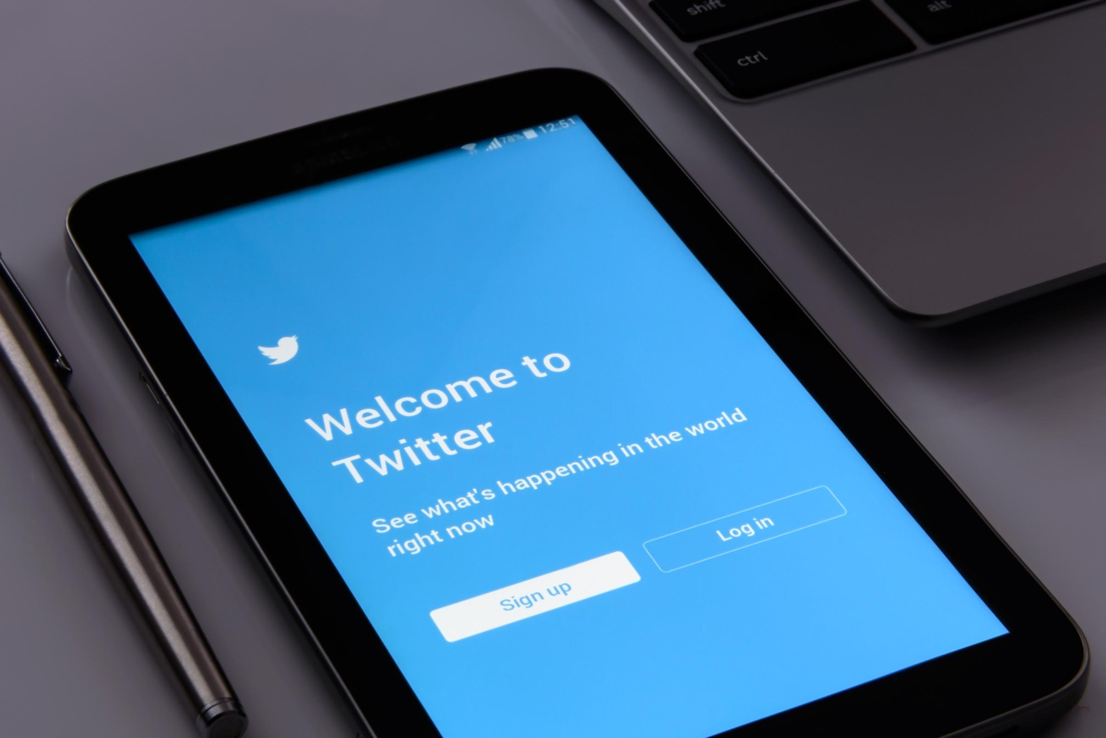

01.
Problem
How does screen time on different social media apps affect anxiety levels in young adults?
Notes:
Manas

Slide 4
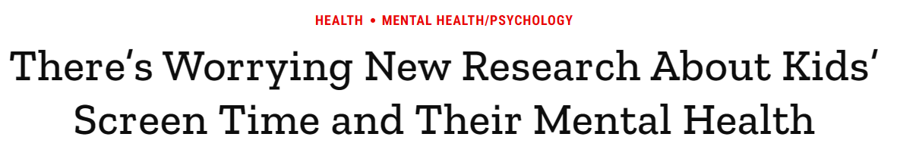
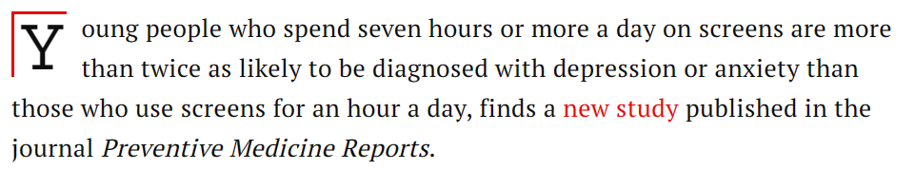
THE PROBLEM
QUESTION: Can the outcome of these studies be replicated with a smaller sample size?
Notes:
Manas

Slide 5
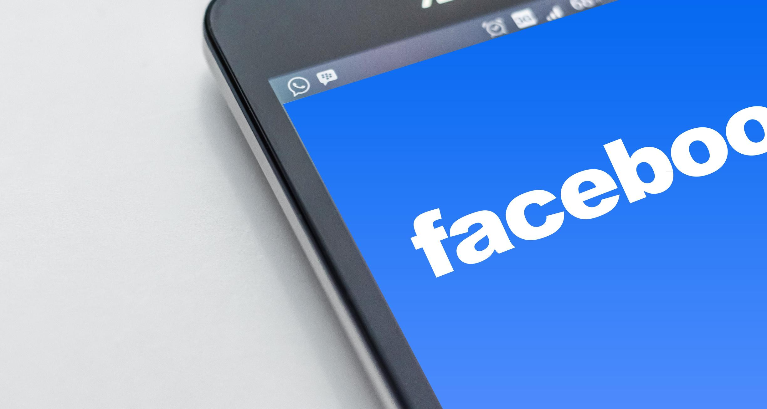
02.
Data Retrieval
Notes:
Leo

Slide 6

CHALLENGES FACED
Lack of raw data surrounding anxiety/mental health and screen time
Most data was already processed/visualized.
Difficulty finding a dataset with a large, representative population
Online datasets were either incomplete or did not have quantifiable variables for mental health
Notes:
Leo

Slide 7




COMPARING DATASETS
GAD-7 CLASS SURVEY
ONLINE DATASET
18 data points from college students
Daily screen time on various apps and corresponding GAD7 score.
470 data points from college students
Daily overall screen time and approximated GAD-7 score
Notes:
Sania

Slide 8
CLEANING DATASETS
Cleaning online dataset for comparison:
Processed the online dataset results into an approximated GAD-7 score (out of 21)
Conversion table for screen time [0-5 scale → minutes]
Median of class dataset minutes → reorganization of online table to follow this median → 50 0.1 increments → convert to minutes
Pulled random sample of 18 datapoints from processed online dataset to compare with class data
Notes:
Sania

Slide 9
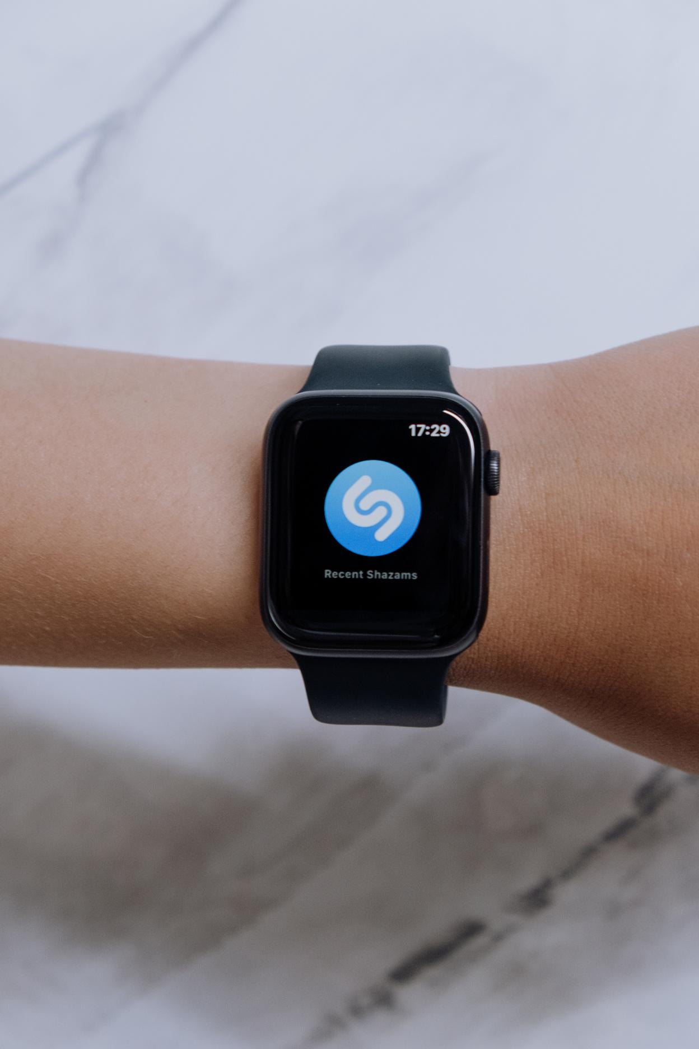
03.
Visualization/Analysis
Notes:
Leo

Slide 10
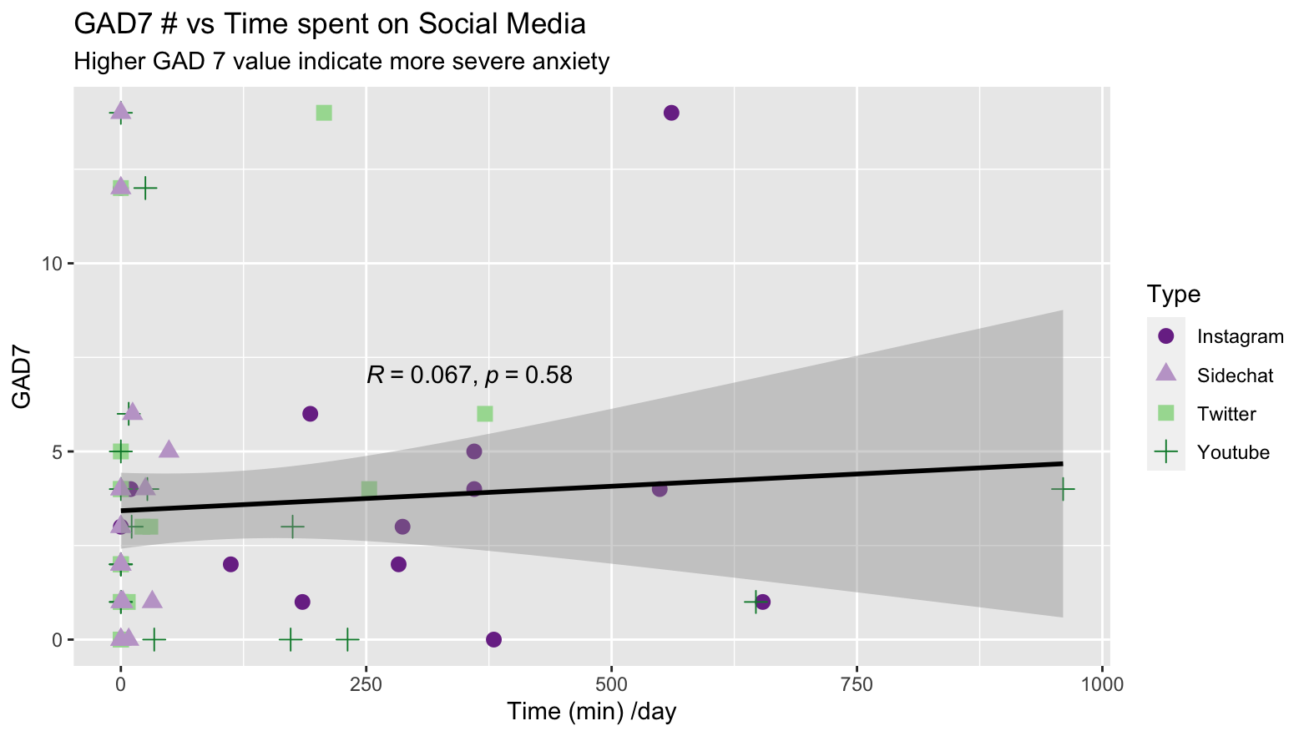
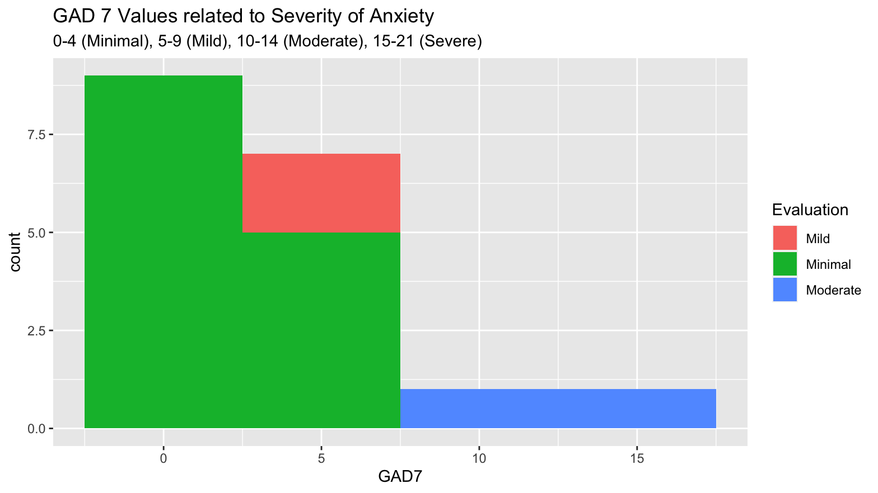
Class Survey
Figure Caption:
GAD7 values plotted in relation to time spent on social media shows visible positive correlation. Different social media used encoded by color and shape provide specific information (fig1).
GAD7 values categorized based on metrics describing severity of anxiety, Data show that the sample pool mostly experience minimal anxiety (fig2).
Gestalt Principles:
Similarity: Each icon is a shape that pertains to the social media platform denoted in the key.
Like colors signify like evaluation of anxiety.
Insert data
Notes:
Leo

Slide 11
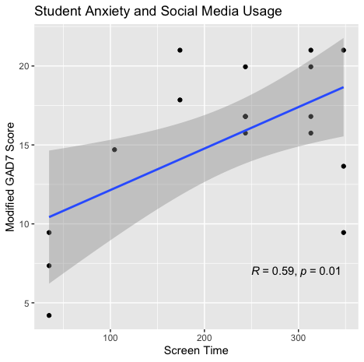
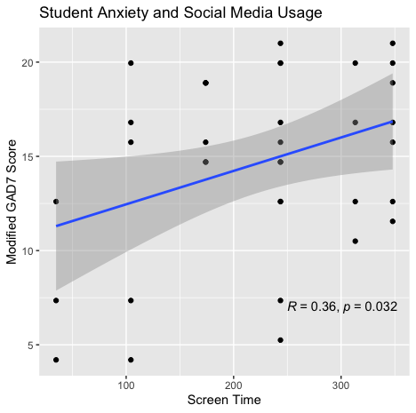
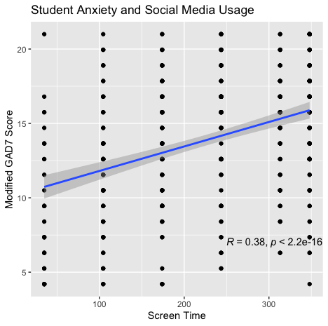
Online Dataset "smmh"
N = 18
(Same as class survey data)
N = 36
(Double class survey data)
N = 481
(All data from online dataset "smmh")
Random N individuals selected from "smmh" data, pearson correlation and linear regression performed with R and p values listed on graph
Figure caption: There is a strong to moderate positive linear correlation between social media screen time and anxiety level. Student data was obtained through an online dataset from a student survey asking how much time is spent on social media and how much anxiety they have on a scale of 1-5. This scale was modified to Screen Time in minutes and a GAD7 score, respectively, using statistical methods. Pearson's correlation was performed across a random sample of N = 18, 36, and 481, ****p < 0.05
Notes:
Rebecca

Slide 12
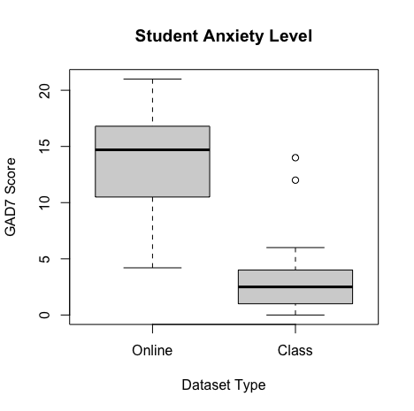
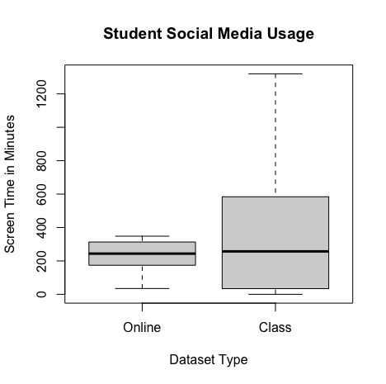
Comparisons
Figure Caption
Boxplot of the GAD7 score show significant higher average value from the online data compared to class data. A t value of 11.113 show significant deviation from the two sample pools (fig1)
Boxplot of the social media usage time between the two sample pools are comparable with a t value of –1.728. Sample sizes differ with the class dataset of 18 and online one of 481(fig2).
GAD7 Scores
Welch 2 Sample Unpaired T-test:
t = 11.113, df = 18.635, p-value = 1.166e-09
Social Media Screen Times
Welch 2 Sample Unpaired T-test:
t = -1.728, df = 17.07, p-value = 0.102
Notes:
Rebecca

Slide 13
Observation
A HIGHER Screen Time correlates to HIGHER GAD7 score.
Notes:
Manas

Slide 14



IMPROVEMENTS
+ FURTHER STUDY
Larger Sample Size
Longitudinal Study
Experimental Study
The primary issue with our collected data set was the small sample size
Sample was not representative of the college student population
Observing changes in anxiety level over an extended period
Simultaneously monitor social media usage and mental health indicators for potential correlation
Rather than surveying individuals, control variables
Expose subjects to varying levels of social media content
Behavioral, anxiety, and physiological assessments
Notes:
Sania

Slide 15
IMPROVEMENTS
+ FURTHER STUDY
Content Analysis
Neuroscientific
Study
Intervention Study
Further analyze content consumed to identify potential triggers
Effects of cyber-bullying, misinformation, comparison stress
Implement strategies to mitigate social media-induced anxiety
Gauge effectiveness of mindfulness programs, etc.
Obtain data on brain activity during social media usage
Analyze for potential links between content, time, or other variables.
Notes:
Manas

